Slide 1
Embedded System

Slide 2
What is an embedded system?
An embedded system is a dedicated system designed for one or two specific/dedicated function(s) within a larger system, often with real time computing constraints.

Slide 3
What is an embedded system?
An embedded system is a
  dedicated system
  designed for one or two specific/dedicated function(s)
  within a larger system,
  often with real time computing constraints.

Slide 4
examples of embedded systems
Some examples of embedded systems are
  MP3 players,
  mobile phones,
  video game consoles,
  digital cameras,
  DVD players,
  GPS
  Household appliances
      microwave ovens,
      washing machines and
      dishwashers,
  to provide flexibility and efficiency.

Slide 5
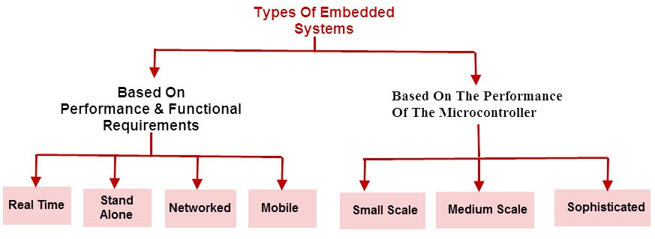

Slide 6
Types of Embedded Systems…
Real-time embedded system:
  Real-time systems are those which give a quick response to critical situations. ...
Standalone embedded system: ...
Networked embedded system: ...
Mobile embedded system: ...
Small-scale embedded system:
  These usually use 8 bit or 16 bit microcontrollers, and have minimum hardware and software.
Medium scale embedded system: ...
Sophisticated embedded system:

Slide 7
OS for embedded systems
Real-time embedded system:
  Real-time systems are those which give a quick response to critical situations.
  For that they generally have their own OS known as Real Time OS [RTOS]

Slide 8
Advantages of embedded operating system
Small size and faster to load
More specific to one task
Easy to manage
Low cost
Spend less resources
These operating system is dedicated to one device so performance is good and use less resources like memory and micro-processors

Slide 9
Disadvantages of embedded operating system
Difficult to upgrade
If any problem occurs then you need to reset settings
Nearly not scalable
Hardware is limited
Troubleshooting is difficult
Difficult to transfer data from one system to other

Slide 10
Examples of Embedded operating system:
Windows Xp using in the ATM machines is one example.
Switches, routers systems are other example in which some embedded system are used which keep them working.
There are many other examples like operating system used in aircrafts, cars etc.

